Slide 1

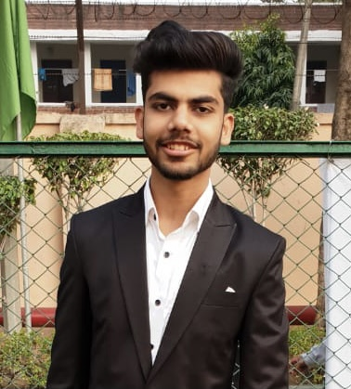
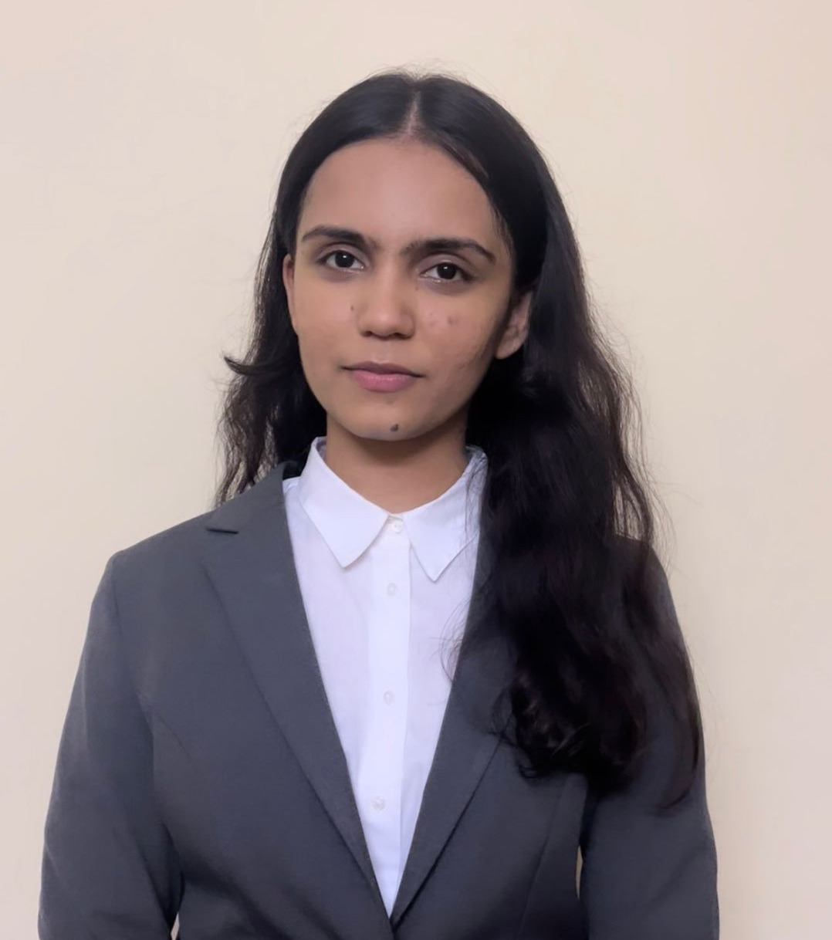
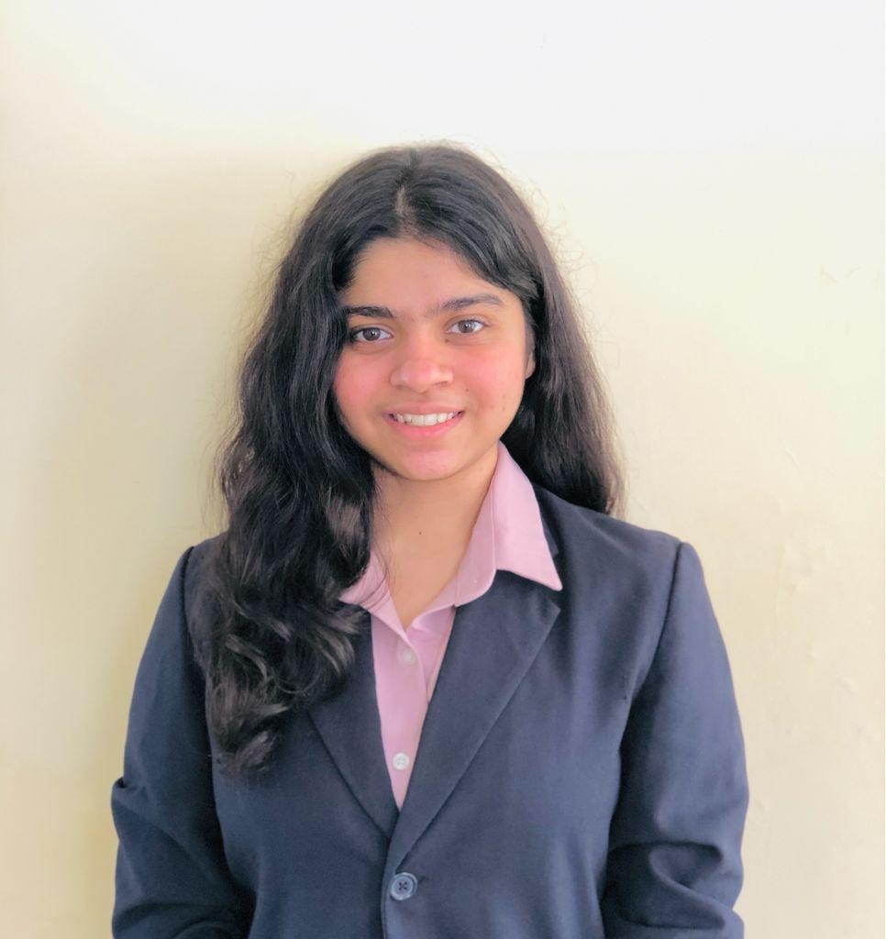
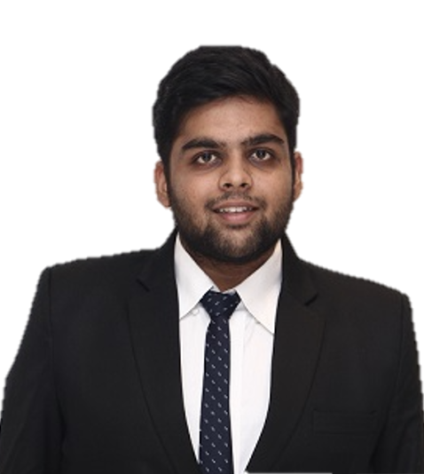
E-Commerce Strategy
- Designing Digital Strategy for a Home Textiles Brand
Team Aspirants
Archit Kapoor
Deeksha Verma
Procurement Lead
Marketing Lead
Hensi Sheth
Sanyam Gupta
Digital Lead
Supply Chain Lead

Slide 2






Ushering a new era of Home Textiles...
Vision 2030
TAM
$0.49 Bn
200,000 MT
.
Recurring offtake through various channels
50%
.
Decrease in Carbon Emissions
SAM
$0.31 Bn
Core Values
Mission Statements
SOM
$0.05 Bn
Customer Centricity
Inclusive Growth
Serve Customers across the country
Innovate & deliver most sustainable products
Digital First
Endless Resilience
Our Core Values are based on the 3 pillars of
Climate
Innovation
Customer
Total Addressable Market (By Top Category)
SAM – Serviceable Addressable Market
SOM – Serviceable Obtainable Market

Slide 3











Primary Research
Consumer Life-Cycle (Micro Analysis)
Awareness
Acquisition
Conversion
Retention
Priority
8 expert interviews
12 homeowners interviews
Inertia, less brand awareness Sustainability, Unorganized market | Reluctance to commit on online platforms, less reviews on e-commerce platforms | High bargaining power of buyers, less brand conscious, variety of options available
Brand awareness & educate, Identify and activate triggers | Testimonials, blogs, featured on credible pages for trust | Tracking and redeeming customers
Bacteria free bedding, Influencer marketing, Bundle pricing, | Video marketing, Discounts, coupons, e-commerce catalogues | Rewards programme, old towel exchange campaign
Gap
Need
5 store interviews
100 survey respondents
Solution
Target Segments
Priority
Cluster 1
Product focused
Middle aged (25-50 yr), Tier 1&2 cities
Sustainability conscious
Awareness regarding finishes
High willingness to pay
Category of Products | Bed Linen, Bath Linen, Flooring | Bed Linen, Bath Linen | Bed Linen, Bath Linen | Bed Linen, Bath Linen, Flooring, Others | Bed Linen, Bath Linen, Flooring
Consumer Needs | Essential | Luxury, Essential, Design, Gifting | Essential, Design, Gifting | Luxury, Design, Gifting | Grey area
Price Segment
Willingness to act sustainably
Cluster 2
Explorers
Leisure shoppers, Tier 1 cities
Young (20-30 yrs.)
Tech-Savvy early adopters
Limited disposable income
Cluster 3
Bargain Hunters
Cost conscious, Tier 2 cities
Durability and fabric of product
Medium disposable income
Not brand conscious
Competitive benchmarking & ABC’s Positioning

Slide 4







A Digital First strategy with an Omni-platform Presence
Customer Journey
Home textiles is a high involvement buying industry
Having and Omni-Channel platform presence will enable: 1) Access to larger TAM 2) Reduce threat due to single provider 3) Match accessibility with competitors
Search
Platform
Compare
Decision
Online SEO
Copymining
Instagram Ads
Occasion Marketing
Offline SEO
Advertorials
Video Ads
Promotional Campaigns
Strategy Actions
Achievable Target
KPIs To Track
Own Website
Run effective SEO
Track metrics effectively
CTR
Brand Authority
E-Commerce Affiliate
Website & Blogs
Easy to Manage
Bounce Rate
Traffic Rate
E-Commerce PPC
Widen Consideration Set
High Visibility
Bounce Rate
CPS
CLV
Influencer Marketing
Video Collaterals
Content Creation
ROAS
CPA
ABC company needs to increase its internet presence to increase penetration and gain a larger market share

Slide 5



















Choosing the right thing for us and our customers
$7 Bn
Hi, I am Sonia. I care more about the price than brand while buying bedsheets
Minimising Cost to Serve
Value Enhancers
$0.49 Bn
$0.05 Bn
Business processes optimization
Tech R&D for mass production
Adapting continuously to fulfil diverse customer needs
ABC’s current share
Potential share
Total Industry Size
Innovation
Sample Persona
Business Metrics
Customer Metrics
.
Providing affordable and sustainable solutions
Establishment of circular supply chain
Bulk Order discounting
Cost Optimisation
- Economies of scale
- Innovation
Price Sensitivity
- High price elasticity
- Competitive Market
Procurement
Competitor Prices
- Competitors might not increase prices
Cost Quality Tradeoff
- Premium products
- Superior quality
Order to collect option
Optimum vehicle usage
Convenience for customers in every stage
Logistics
Vision Alignment
- Increased sales
- Cater to all
customer groups
Cost to Search
- Multiple platforms
- Focused campaigns
Profitability
- Margins
- Increasing costs
Brand Awareness
- Variety of products
- Focused campaigns
Minimum downtime
Cheaper renewable energy options
Standardized quality products with high trust
Production
ABC should focus on Volume driven growth:
Focused campaigns using analytics
Improving referrals to reduce acquisition cost
Relevant content/ campaigns for customers
Marketing
Opportunity to become the market leader
Benefit from price sensitivity of customers
Large data collection due to larger penetration

Slide 6



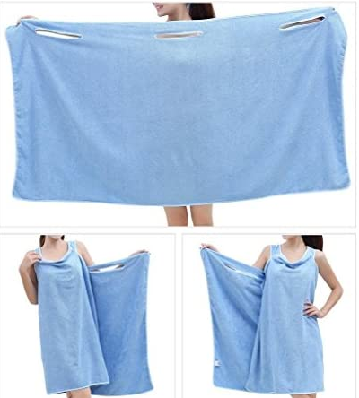
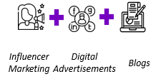

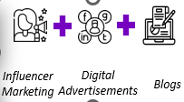
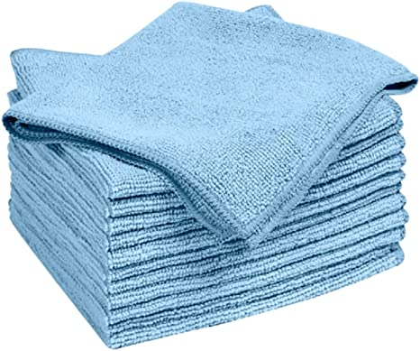

Our Campaigns
#AbHarGharABC
“CHAUNK JAOGE”
Thicker, lighter and sustainable towel, but takes no time to dry! Self-cleaning Towel with no laundry or bathrobe buying hassle
Tier 2 penetration of organized home textile brands is less due to less brand conscious consumers
Concept: Pioneering the Hostess Group Demonstrations in order to tap into the power of women’s social networks for personalized demonstrations of bed and bath linen products.
Concept:
A survey questionnaire was floated amongst the users to understand
their perspectives towards sustainable towels
1: Dentists’ recommendations a
A powerful nudge to try ETB
2. First time customers are more
comfortable with price <₹1,000
#GoGreenWithABC
Our customers are becoming environment conscious by the day
80.0%
respondents find It moderate to very imp that brands are environmentally responsible
86.0%
respondents are willing to change their purchasing habits to help reduce negative effects on the environment.
Concept: Run social media campaigns with the hashtag #GoGreenWithABC to engage customers. With this, we will provide customers discount coupons if they return their used towels & bedsheets
Target Segment
Product Portfolio
Media & Retail Strategy
“ Naya Saaz, Naya Rishta”
Mid Price Entry level Sustainable towel
What festivals mean to engaged Customers?
1.
Middle-aged (25-50 yrs.)
Working professionals
High disposable income
Sustainable buying behavior
Self cleaning towel
Towel cum bathrobe
Concept: Run campaigns like “This Diwali, Make a change” & “no to crackers”, showing the family spreading a new air purifying bedsheets & comforters in a home filled with Diyas
2.
Young (15-30 yrs.)
Tech-Savvy early adopters
Limited disposable income
High future earning potential
Low-Mid Price Entry level Sustainable towel
E-Commerce Flash Sales, Product Promotion pages
Anti-Bacterial, Self-cleaning towel

Slide 7




ABC wants to be a front runner by focusing on
Digital First
Circular Supply Chain
Innovation Lab
Penetration
Human Centricity
Tech for service delivery, metaverse marketplace
Mitigating affects of fluctuation in raw material prices
Solving customer pain points through constant innovation
Developing brand & category awareness in Tier II cities
Mitigating harm from value chain activities
Transforming value chain activities to become more cost optimized
Improving on sustainability to recycle and reduce wastage
Product Innovation through sustained R&D efforts & investment
Transformational Delivery Channel providing self subsistence opportunities
Transforming value chain activities to become more sustainable
While ensuring high financial growth…
Yearly Revenue Growth
95
7

Slide 8
Choosing the right thing for us and our customers
$7 Bn
Hi, I am Sonia. I care more about the price than brand while buying bedsheets
Minimising Cost to Serve
Value Enhancers
$0.49 Bn
$0.05 Bn
Continuous business processes optimization
Tech R&D for cost effective mass production
ABC’s current share
Potential share
Total Industry Size
Sample Persona
Innovation
Business Metrics
Customer Metrics
Cost Optimisation
- Economies of scale
- Innovation
Price Sensitivity
- High price elasticity
- Competitive Market
Continuous business processes optimization
Tech R&D for cost effective mass production
Procurement
Competitor Prices
- Competitors might not increase prices
Cost Quality Tradeoff
- Premium products
- Superior quality
Logistics
Vision Alignment
- Increased sales
- Cater to all
customer groups
Cost to Search
- Multiple platforms
- Focused campaigns
Production
Profitability
- Margins
- Increasing costs
Brand Awareness
- Variety of products
- Focused campaigns
Marketing
ABC should focus on Volume driven growth:
Opportunity to become the market leader
Benefit from price sensitivity of customers
Lack of clarity on decision of competitors

Slide 9
Our Potential & Our Vision
Strategic Intent
TAM
$0.49 Bn
Vision
Mission
SAM
$0.31 Bn
Serve Customers across the country
Innovate & deliver most sustainable products
$0.05 Bn
To be the most customer focused company
SOM
Our Core Values are based on the 3 pillars of
Climate
Innovation
Customer
Total Addressable Market (By Top Category)
SAM – Serviceable Addressable Market
SOM – Serviceable Obtainable Market

Slide 10
Omni-platform Presence & Digitized Marketing Funnel for a holistic strategy
Customer Journey
Home textiles is a high involvement buying industry
Having and Omni-Channel platform presence will enable: 1) Access to larger TAM 2) Reduce threat due to single provider 3) Match accessibility with competitors
Search
Platform
Compare
Decision
Online SEO
Copymining
Instagram Ads
Occasion Marketing
Offline SEO
Advertorials
Video Ads
Promotional Campaigns
Strategy Actions
Achievable Target
KPIs To Track
Own Website
Run effective SEO
Track metrics effectively
CTR
Brand Authority
E-Commerce Affiliate
Website & Blogs
Easy to Manage
Bounce Rate
Traffic Rate
E-Commerce PPC
Widen Consideration Set
High Visibility
Bounce Rate
CPS
CLV
ABC company needs to increase its internet presence to increase penetration and gain a larger market share
Influencer Marketing
Video Collaterals
Content Creation
ROAS
CPA

Slide 11


Choosing the right thing for us and our customers
Cost Optimisation strategies
Factors
Comments
Volume Driven Growth
Hike Prices
Innovation
Continuous focus on innovation to optimize business processes
Leveraging IoT to automate processes
Price Sensitivity
High price elasticity
Competitive Market
Large market
Can cater to other segments
Market Size
Negotiating contracts with suppliers
Place bulk orders with suppliers at higher discounts
Procurement
Cost Optimisation
Optimising inbound and outbound vehicle usage
Option for customers to collect/return orders at stores
Competitors Prices
Competitors might not increase prices
Logistics
Brand Perception
Premium products
Superior quality
Production
Focus on economies of scale
Lower dependence on raw materials
ABC should focus on Volume driven growth:
Opportunity to become the market leader
Customers are price elastic and switch to other brands
Lack of clarity on decision of competitors
Marketing Costs
Use of analytics for focused campaigns
Improving retention rate and referrals
Favourable
Unfavourable

Slide 12
Our Campaigns
#AbHarGharABC
Strategic Initiatives
Tier 2 penetration of organized home textile brands is less due to less brand conscious consumers
Circular Supply Chain
Concept: Pioneering the Hostess Group Demonstrations in order to tap into the power of women’s social networks for personalized demonstrations of bed and bath linen products.
Sustainable processes for cost optimization by cutting down raw material cost through recycling
Market Penetration
Move into Tier II cities thorugh innovative indirect channels, increasing category awareness
#GoGreenWithABC
Our customers are becoming environment conscious by the day
Concept: Run social media campaigns with the hashtag #GoGreenWithABC to engage customers. With this, we will provide customers discount coupons if they return their used towels & bedsheets
Innovation Lab
Meeting Pain Points of customers through product innovation
“ Naya Saaz, Naya Rishta”
What festivals mean to engaged Customers?
Concept: Run campaigns like “This Diwali, Make a change” & “no to crackers”, showing the family spreading a new air purifying bedsheets & comforters in a home filled with Diyas

Slide 13









ABC continues to balance the Social-Business Continuum
Product segment & Sample product
Customer personas
Media strategy
Retail strategy
Mid-High Price Premium
Sustainability driven
Towel cum bathrobe
Middle Aged, working professionals with High disposable income
E-Commerce Flash Sales, Product Promotion pages
Young, Early adopters
Influencer Marketing
Digital Advertisements
Blogs
Anti-bacterial self-cleaning
Social dimensions of competitive context
Vision 2030
Value chain social impacts
1.4 MT
Carbon emissions offset per product per year by introducing Sustainable & organic bedding
38 kg
CO₂ emissions saved by deploying xxx
Mitigating harm from value chain activities
Strategic philanthropy by introducing a new sustainable product line
Transforming value chain activities to become more sustainable
STRATEGIC CSR
13

Slide 14
ABC wants to be a front runner by focusing on
Digital First
Circular Supply Chain
Innovation Lab
Penetration
Human Centricity
Tech for service delivery, metaverse marketplace
Mitigating affects of fluctuation in raw material prices
Solving customer pain points through constant innovation
Developing brand & category awareness in Tier II cities
Mitigating harm from value chain activities
Transforming value chain activities to become more cost optimized
Improving on sustainability to recycle and reduce wastage
Product Innovation through sustained R&D efforts & investment
Transformational Delivery Channel providing self subsistence opportunities
Transforming value chain activities to become more sustainable
While ensuring high financial growth…
14

Slide 15

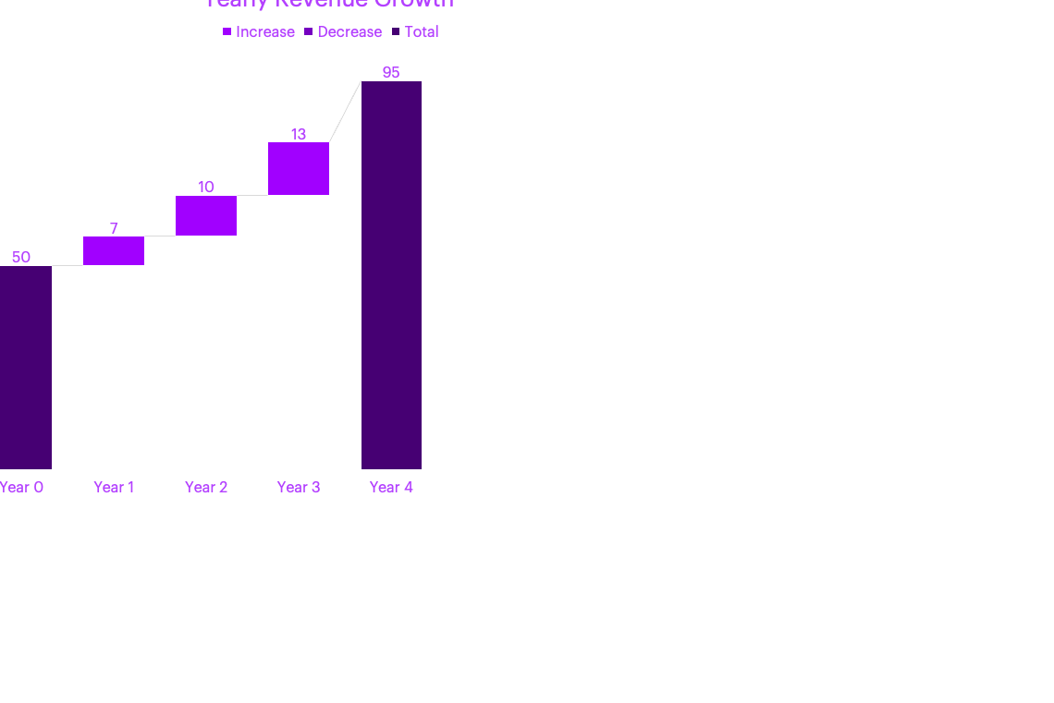

Slide 17
Addressable Ecommerce Market
Segmentation & Cluster Analysis
Competitor Benchmarking
Channel Strategy & Portfolio Strategy
Digital Marketing Mix
Campaigns & Feasibility Analysis
“ Naya Saaz, Naya Rishta”
#GoGreenWithABC
#AbHarGharABC
What festivals mean to engaged Customers?
Our customers are becoming environment conscious by the day
Tier 2 penetration of organized home textile brands is less due to less brand conscious consumers
Concept: Run campaigns like “This Diwali, Make a change” to telling everyone to say no to crackers and showing the family spreading a new air purifying bedsheets and comforters in a home filled with Diyas
Concept: We aim to run social media campaigns with the hashtag #GoGreenWithABC to engage our customers on social media. With this, we will provide our customers discount coupons if they return their used towels & bedsheets
Concept: Pioneering the Hostess Group Demonstrations in order to tap into the power of women’s social networks for personalized demonstrations of bed and bath linen products.
Rationale: Traditionally, festivals meant spending time & enjoying with friends, neighbors & family so associating ABC with festivals would garner positive sentiment around the brand
Rationale: We have long seen this trend that customers usually don't dispose off their old towels & bedsheets. We plan to receive these back from customers in order to recycle the same.
Rationale: Expanding reach and building trust in Tier 2 cities is a little tricky in India. Here, we are empowering women to become independent ABC dealers.
Feasibility Analysis
Cost factor | Unit cost | Conversion Rate | Cost in Year 1 (INR) | Cost in Year 2 (INR) | Cost in Year 3 (INR)
Website maintenance | - | - | 1,50,000 | 70,000 | 70,000
Paid search | Cost per click = Rs.6 | 2.50% | 36,00,000 | 36,00,000 | 36,00,000
Paid social | Avg engagement ratio = 5% | 5% | 30,00,000 | 31,50,000 | 33,07,500
Affiliates | Cost per sale = 8% |  | 3,40,000 | 3,40,000 | 3,40,000
Direct reach | Cost per E-mail= INR 0.0425 | 1.50% | 42,500 | 43,775 | 45,088
Total cost |  |  | 71,32,500 | 72,03,775 | 73,62,588

Slide 18
Addressable Ecommerce Market Size
Addressable Ecommerce Market
Segmentation & Cluster Analysis
Competitor Benchmarking
Channel Strategy & Portfolio Strategy
Digital Marketing Mix
Campaigns & Feasibility Analysis
Total Addressable Market (By Category)
Supermarkets & Hypermarkets
Bedsheets
45%
$0.22 Bn
Home Textile Market Size
7%
Online
15%
Towels
$7 Bn
$0.49 Bn
20%
$0.075 Bn
Speciality Stores
Top of Bed
TAM
$ 0.49Bn
$0.10 Bn
SAM
$ 0.31Bn
Serviceable Addressable Market
Serviceable Obtainable Market
SOM
$ 0.05Bn
Total Addressable Market
$0.49 Bn
Current Share of ABC = 10%
(leading home textile player)
22%
40%
38%
Potential increase in share = 5%
(campaigns and ideal portfolio mix)
Tier 1/ Metro
Tier 2
Tier 3
Assumptions:
Current share of ABC is 10% as it is a leading player
People are willing to switch between brands and there is scope to gain market share
Only targeting tier 1 and 2 cities and ignoring tier 3
$0.11 Bn
$0.20 Bn
$0.18 Bn
SAM = 0.11 + 0.20 = 0.31 Bn
SOM = 0.15*0.31 = 0.05 Bn
Source: EMIS Reports, Textile Ministry

Slide 19



Addressable Ecommerce Market
Segmentation & Cluster Analysis
Competitor Benchmarking
Channel Strategy & Portfolio Strategy
Digital Marketing Mix
Campaigns & Feasibility Analysis
Income based segmentation
Cluster Analysis for Segmentation
Target market
Priority
Towels
Bedsheets
5 point agreement scale
Cluster 1
Product focused
Middle aged (25-50 yr), Tier 1&2 cities
Sustainability conscious
Awareness regarding finishes
High willingness to pay
Priority
 | 1 | 2 | 3
Lacks_Time | 4.15 | 2.65 | 2.00
Lacks_Knowledge | 3.02 | 3.90 | 3.07
Ecofriendly_Finishes | 3.80 | 2.71 | 1.93
Designs | 3.78 | 3.90 | 1.64
Wellness_Hygiene | 3.22 | 4.03 | 3.21
Durability | 3.64 | 2.30 | 1.92
Cost_Saving | 3.00 | 3.68 | 4.21
Age | 3.69 | 4.10 | 4.29
Functional benefits | 2.31 | 3.61 | 4.14
Brand_Conscious | 3.20 | 3.79 | 2.21
Trend_conscious | 2.15 | 3.81 | 3.30
Mid price
Premium
Mid price
Premium
Low
price
Cluster 2
Explorers
Leisure shoppers, Tier 1 cities
Young (20-30 yrs.)
Tech-Savvy early adopters
Limited disposable income
*Weighted avg of prod portfolio across segments on 3 platforms
Cluster 3
Bargain Hunters
Cost conscious, Tier 2 cities
Durability and fabric of product
Medium disposable income
Not brand conscious
Geographic presence
Current | Proposed
Metro cities | Tier 1 & 2 cities
Expert talks & secondary research
Consumer Life-Cycle (Micro Analysis)
Awareness
Acquisition
Conversion
Retention
Telephonic discussion with 8 interior designers, from Gujarat across tier-I,II cities. Research report on home textiles market on Euromonitor, CRISIL on e-commerce
Inertia, less brand awareness Sustainability, Unorganized market | Reluctance to commit on online platforms, less reviews on e-commerce platforms | High bargaining power of buyers, less brand conscious, variety of options available
Brand awareness & educate, Identify and activate triggers | Testimonials, blogs, featured on credible pages for trust | Tracking and redeeming customers
Bacteria free bedding, Influencer marketing, Bundle pricing, | Video marketing, Discounts, coupons, e-commerce catalogues | Rewards programme, old towel exchange campaign
Gap
Customer Interviews & Survey
Need
In-depth interviews of 7 homeowners, 5 on rentals & assisted online survey of 100 people
tier-I, II, III cities; age: 25 to 50.
Solution

Slide 20

Addressable Ecommerce Market
Segmentation & Cluster Analysis
Competitor Benchmarking
Channel Strategy & Portfolio Strategy
Digital Marketing Mix
Campaigns & Feasibility Analysis
High
Low
Bed Linen
Price
High
Category of Products | Bed Linen, Bath Linen, Flooring | Bed Linen, Bath Linen | Bed Linen, Bath Linen | Bed Linen, Bath Linen, Flooring, Others | Bed Linen, Bath Linen, Flooring
Consumer Needs | Essential | Luxury, Essential, Design, Gifting | Essential, Design, Gifting | Luxury, Design, Gifting | Grey area
Price Segment
Willingness to act sustainably
Quality
Low
Bath Linen
Price
Softness
Value Based pricing across all the segments
Penetration in market that is not brand loyal
Differentiated play
Promotional campaigns focused on increasing revenue from Amazon, Flipkart
Others*
Price
Price
Place
Promotion
Products
Widening the marketing funnel to increase brand awareness, desire to transact & purchase intent
Super soft, quick dryer, anti microbial towels. High quality designs matching any decor
Design

Slide 21
Having an omni-platform presence will facilitate high growth
Addressable Ecommerce Market
Segmentation & Cluster Analysis
Competitor Benchmarking
Channel Strategy & Portfolio Strategy
Digital Marketing Mix
Campaigns & Feasibility Analysis
Comparative favourability of platforms
Unfavourable
Favourable
Having and Omni-Channel platform presence will enable: 1) Access to larger TAM 2) Reduce threat due to single provider 3) Match accessibility with competitors
Market Size
Online experience store
Commission Cost
Envelopment Threat
Category Relevance
Favourable | Favourable | Factoring in growth rate (Exhibit 3) | Bedsheet | Towel | Top of bed
Amazon | 70% |  | 34% | 41% | 39%
Flipkart | 58% |  | 25% | 21% | 23%
Myntra | 66% |  | 41% | 38% | 37%
*Upper range of growth rate in exhibit 3 is considered for calculations

Slide 22
ABC needs to widen its marketing funnel, follow a holistic digital strategy
Addressable Ecommerce Market
Segmentation & Cluster Analysis
Competitor Benchmarking
Channel Strategy & Portfolio Strategy
Digital Marketing Mix
Campaigns & Feasibility Analysis
Customer Journey
Online SEO
Home textiles is a high involvement buying industry
Offline SEO
Awareness
Instagram Ads
Video Ads
Search
Platform
Compare
Decision
Consideration
Copymining
Advertorials
Strategy Actions
Achievable Target
KPIs To Track
Purchase
Own Website
Run effective SEO
Track metrics effectively
CTR
Brand Authority
Occasion Marketing
Promotional Campaigns
E-Commerce Affiliate
Website & Blogs
Easy to Manage
Bounce Rate
Traffic Rate
Personalized Emails
E-Commerce PPC
Widen Consideration Set
High Visibility
Bounce Rate
CPS
ABC company needs to increase its internet presence to increase penetration and gain a larger market share
CLV
Influencer Marketing
Video Collaterals
Content Creation
ROAS
CPA

Slide 23
ABC needs to widen its marketing funnel, follow a holistic digital strategy
Addressable Ecommerce Market
Segmentation & Cluster Analysis
Competitor Benchmarking
Channel Strategy & Portfolio Strategy
Digital Marketing Mix
Campaigns & Feasibility Analysis
Customer Journey
Online SEO
Home textiles is a high involvement buying industry
Offline SEO
Awareness
Instagram Ads
Video Ads
Search
Platform
Compare
Decision
Consideration
Copymining
Advertorials
Strategy Actions
Achievable Target
KPIs To Track
Purchase
Own Website
Run effective SEO
Track metrics effectively
CTR
Brand Authority
Occasion Marketing
Promotional Campaigns
E-Commerce Affiliate
Website & Blogs
Easy to Manage
Bounce Rate
Traffic Rate
Personalized Emails
E-Commerce PPC
Widen Consideration Set
High Visibility
Bounce Rate
CPS
ABC company needs to increase its internet presence to increase penetration and gain a larger market share
CLV
Influencer Marketing
Video Collaterals
Content Creation
ROAS
CPA

